Slide 1

MARKET INTELLIGENCE · PLATFORM SHOWCASE
Weight-Management GLP-1s in London’s Hospitals
How Mounjaro overtook Wegovy across NHS secondary care in Greater London
Wegovy (Novo Nordisk) Mounjaro (Eli Lilly)
Auto-generated sample from public NHS data, for quick interest — showing the kind of data that exists and what it reveals. Commissioned client reports are individually human-checked. · Source: NHS England SCMD
RxLens is a product of Nexcea Limited

Slide 2
EXECUTIVE SUMMARY
In London, Mounjaro has already overtaken Wegovy — and is pulling away
56%
+62%
25 / 27
£4.06m
Mounjaro share of patients (Wegovy 44%)
Mounjaro growth, H2 vs H1 of the year
London Trusts where Mounjaro leads
combined indicative annual spend
Bottom line: unlike the national picture, in London Mounjaro already leads Wegovy on patients and is dispensed in every London Trust that uses these drugs. Wegovy’s volume is now concentrated in two Trusts — St George’s and Imperial — while Mounjaro leads broadly and continues to grow.
RxLens · Platform showcase · NHS secondary care, Greater London · Apr 2025–Mar 2026
Source: NHS England SCMD
1

Slide 3
THE CONTENDERS
Two once-weekly injections, two companies, one fast-moving market
Wegovy
Mounjaro
Novo Nordisk
Eli Lilly
Semaglutide. Once-weekly injection, maintenance 2.4 mg/week. NICE-recommended in specialist weight-management services (up to 2 years).
Tirzepatide (dual GIP/GLP-1). Once-weekly, 5–15 mg/week. NICE-recommended for weight management; also licensed for type-2 diabetes.
Both are once-weekly injections provided through hospital-based specialist services — which is why NHS secondary-care data captures them well.
RxLens · Platform showcase · NHS secondary care, Greater London · Apr 2025–Mar 2026
Source: NHS England SCMD
2

Slide 4
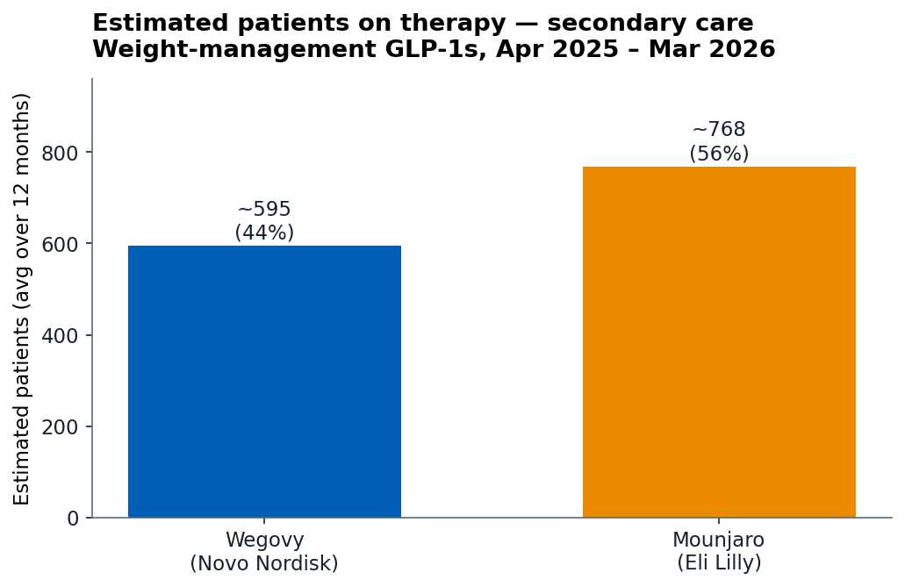
VOLUME
~1,360 patients and ~£4.06m a year flow through London’s weight services
~1,363
70.9k
£4.06m
patients on treatment
patient-weeks (12 mo)
indicative annual spend
Brand | Patient-weeks | ≈ Patients | Cost
Mounjaro | 39,956 | ~768 | £2.66m
Wegovy | 30,935 | ~595 | £1.41m
Total | 70,891 | ~1,363 | £4.06m
Mounjaro treats more patients in London and costs more per patient — so it leads on both volume and spend.
RxLens · Platform showcase · NHS secondary care, Greater London · Apr 2025–Mar 2026
Source: NHS England SCMD
3

Slide 5
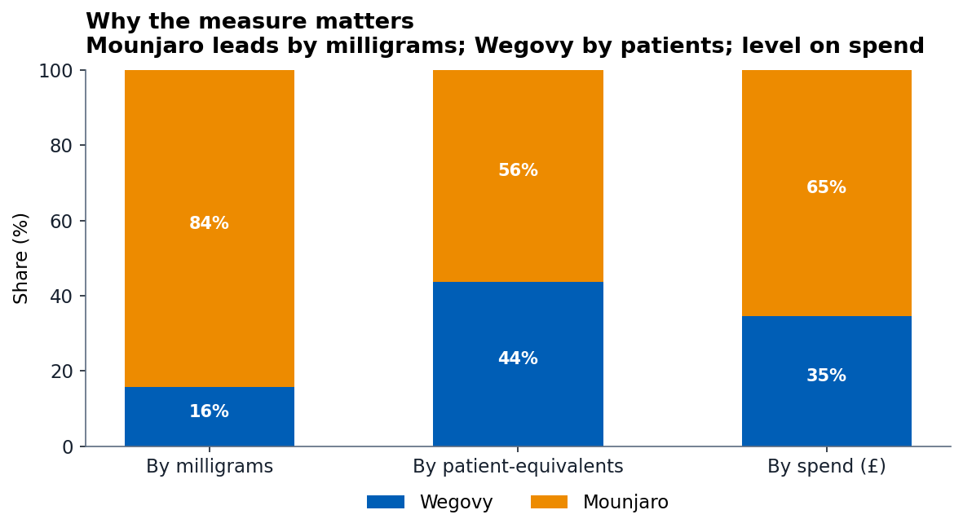
READ THE DATA RIGHT
How you count matters — by patients, the race is close, not a blowout
The same two products, three answers.
• By milligrams: Mounjaro ~84% — but meaningless (a tirzepatide dose is far more mg than semaglutide).
• By patient-equivalents (the fair measure): Mounjaro 56% / Wegovy 44%.
• By spend: Mounjaro 65% / Wegovy 35%.
We convert everything to patient-weeks before comparing — raw volume would overstate Mounjaro’s lead.
RxLens · Platform showcase · NHS secondary care, Greater London · Apr 2025–Mar 2026
Source: NHS England SCMD
4

Slide 6
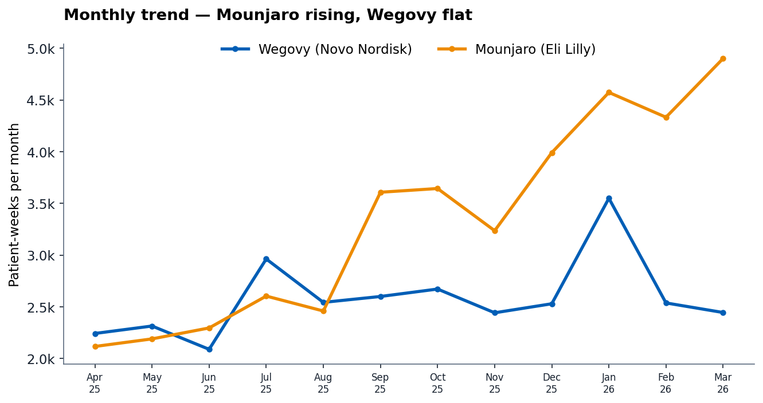
MOMENTUM
Mounjaro crossed over during the year and keeps pulling away
Wegovy
+1.6%/mo · broadly flat; +10% half-on-half
Mounjaro
+7.9%/mo · +62% half-on-half; lead widening
RxLens · Platform showcase · NHS secondary care, Greater London · Apr 2025–Mar 2026
Source: NHS England SCMD
5

Slide 7
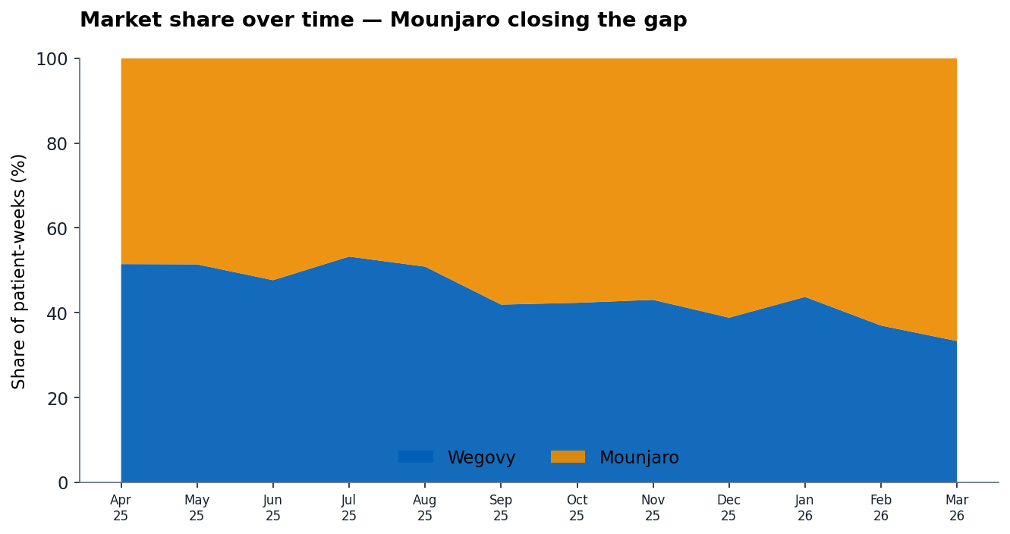
SHARE & CONCENTRATION
Mounjaro is dispensed everywhere; Wegovy’s volume sits in a few Trusts
 | Wegovy | Mounjaro
Trusts dispensing | 14 | 27
Top-5 share of volume | 95% | 75%
HHI (concentration) | 3,304 | 3,269
Both highly concentrated (HHI > 2,500). A small number of London Trusts account for most of the volume of both products.
RxLens · Platform showcase · NHS secondary care, Greater London · Apr 2025–Mar 2026
Source: NHS England SCMD
6

Slide 8
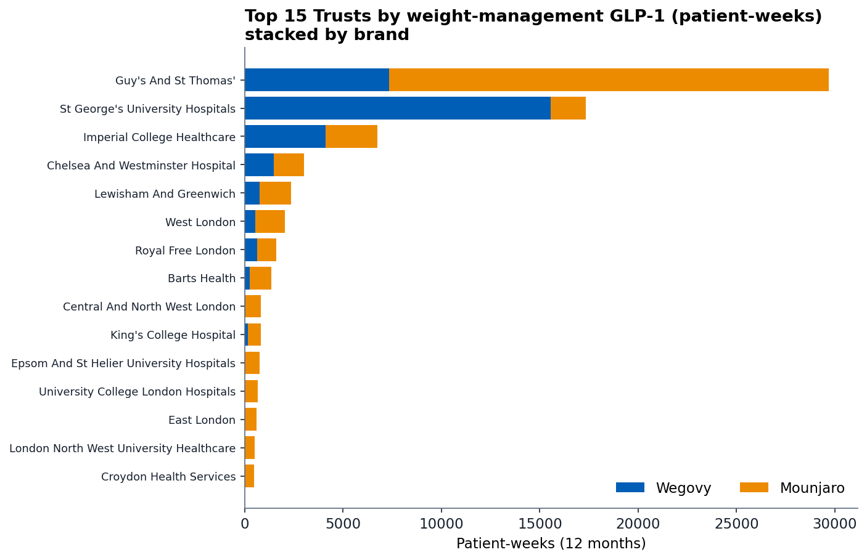
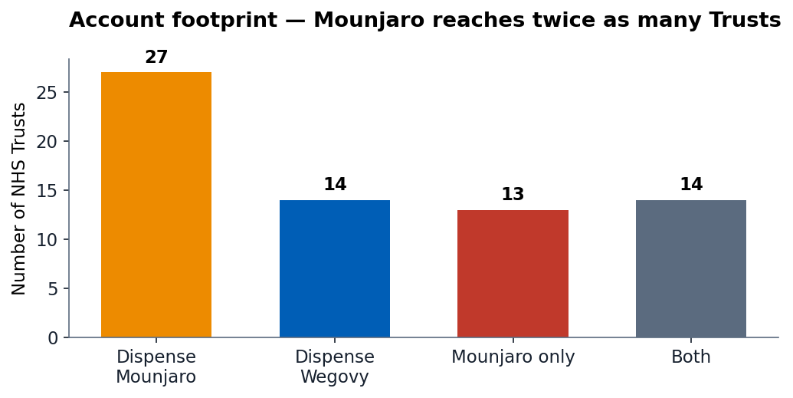
BY NHS TRUST
Two Trusts stand out: Guy’s & St Thomas’ (Mounjaro) and St George’s (Wegovy)
27 London Trusts dispense one or both.
Mounjaro 27 · Wegovy 14 · 14 use both. Every Wegovy Trust also uses Mounjaro. Guy’s & St Thomas’ is the biggest single account (Mounjaro); St George’s is Wegovy’s anchor. This is a map of current activity, not won or lost ground.
RxLens · Platform showcase · NHS secondary care, Greater London · Apr 2025–Mar 2026
Source: NHS England SCMD
7

Slide 9
STRESS TEST
Mounjaro leads London at every realistic dose assumption
Mounjaro dose | Mounjaro patients | Mounjaro share
5 mg/week | ~1,537 | 72%
7.5 mg/week | ~1,025 | 63%
10 mg/week (base) | ~768 | 56%
12.5 mg/week | ~615 | 51%
15 mg/week (max) | ~512 | 46%
Robust conclusion.
Wegovy’s dose is fixed at 2.4 mg; Mounjaro’s maintenance can be 5–15 mg. Across that whole range, Mounjaro leads London up to 12.5 mg/week, and only at the maximum 15 mg does it fall to level. “Mounjaro is ahead in London” holds under all but the most aggressive dosing — and its growth is the headline regardless.
RxLens · Platform showcase · NHS secondary care, Greater London · Apr 2025–Mar 2026
Source: NHS England SCMD
8

Slide 10
WHAT THE PLATFORM DELIVERS
From one public dataset
1
Market size & momentum
2
Competitive position
how big, and how fast it’s moving
share by the measure that matters, over time
3
Where the activity is
4
Trend tracking
the Trusts where dispensing is concentrated
movement followed month by month as data lands
5
Data-quality flags
6
Stress-tested findings
anomalies surfaced before drawing conclusions
conclusions checked against key assumptions
Report · slide deck · interactive dashboard — built from public NHS data, in days. Commissioned client reports are fully human-checked.

